Slide 1
2017 ITRC Annual Meeting Technical team update

Slide 2
Bioavailability
Bioavailability in Contaminated Soil
Kathryn Durant
Delaware DNREC
Claudio Sorrentino
California EPA – DTSC

Slide 3
Bioavailability FOCUS & STATUS
Using site-specific soil bioavailability measurements for Pb, As, and PAH risk assessments and site decisions
Addressing external review comments and preparation of Internet Based Training

Slide 4
Complex sites
Remediation Management of Complex Sites
John Price III
Washington Dept Ecology
Carl Spreng
Colorado DPHE

Slide 5
Complex Sites FOCUS & STATUS
Providing a technical foundation for predictive analysis and remedy implementation at complex sites
Undergoing peer review for final edits and public preparation

Slide 6
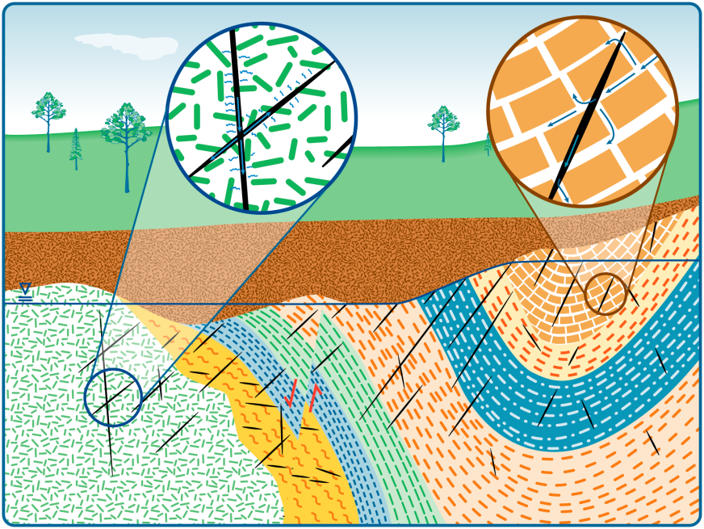
Fractured Rock
Characterization and Remediation in Fractured Rock
Naji Akladiss
Maine DEP
Michael Smith
Vermont DEC

Slide 7
Fractured Rock FOCUS & STATUS
Describing characterization parameters and remediation techniques for common contaminants in fractured bedrock
Preparing for external review and final edits

Slide 8
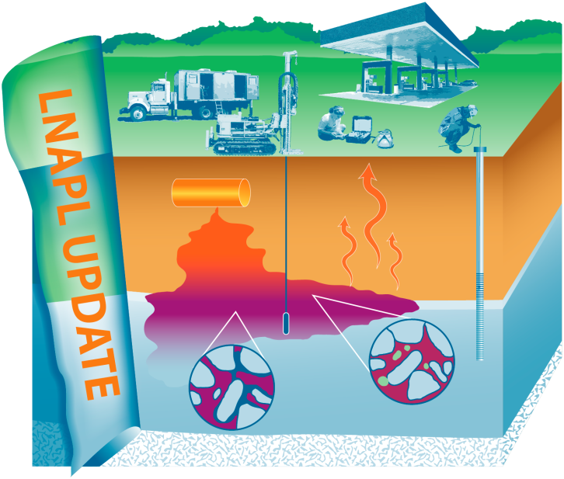
LNAPL
Light Non-Aqueous Phase Liquids Update
William Chapman
Virginia DEQ
Erik Gessert
Colorado – Oil & Public Safety

Slide 9
LNAPL
Examining assessment and management practices for LNAPL contaminated sites
Finalized a complete internal draft; will review, discuss, and streamline for the development of the external draft to be completed in Summer 2017

Slide 10
methane
Evaluation of Innovative Methane Detection Technologies
Lisa Dorman
Pennsylvania DEP
Timothy Taylor
Colorado DPHE

Slide 11
Methane FOCUS & STATUS
Creation of a standardized evaluation methodology for methane-detection technologies
Completing and reviewing drafts of the main sections of the Technical-Regulatory Guidance document

Slide 12
Munitions
Quality Considerations for Multiple Aspects
of Munitions Response Sites
William Harmon
Michigan DEQ
Roman Racca
California EPA – DTSC

Slide 13
Munitions FOCUS & STATUS
Integrating QA/QC programs to support geophysical classification
Internal draft under team review to prepare for external draft review in Summer 2017

Slide 14
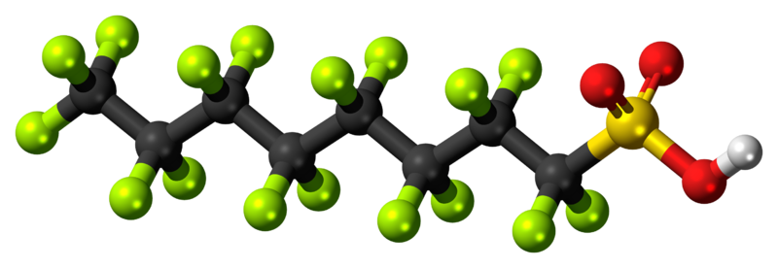
PFASs
Key Information Needed to Develop Strategies to Address Environmental Releases of Per- and Polyfluoroalkyl Substances
Robert Mueller
New Jersey DEP
Ginny Yingling
Minnesota Dept. Health

Slide 15
PFASs FOCUS & STATUS
Scientific understanding of PFASs and compiling information for easy access to project managers about adverse environmental effects, sources, characterization tools, and remediation methods for PFASs
Separating into sub-teams and preparing six fact sheets
of concise technical information

Slide 16
Stormwater
Stormwater BMP Performance Evaluation
Rebecca Higgins
Minnesota PCA
Allison Dunaway
Virginia DEQ

Slide 17
STORMWATER FOCUS & STATUS
Evaluating pollution-reduction capabilities and stormwater BMP performance
First document draft is in editing mode and informational tool is under development

Slide 18
TPH
TPH Risk Evaluation at Petroleum-Contaminated Sites
Thomas Booze
California EPA – DTSC
Michael Kwiecinski
Colorado – Oil & Public Safety

Slide 19
TPH FOCUS & STATUS
Facilitating better informed decisions relating to the evaluation of TPH risk at petroleum contaminated sites, including field and laboratory analyses and data interpretation for regulators and consultant project managers, who may not be skilled in risk assessment
Undergoing further draft compilation and editing

