Slide 1
Outreach Slides
By: Author

Slide 2
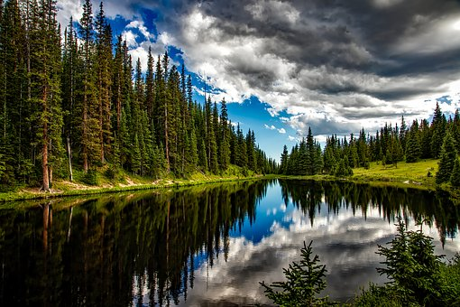
What is ITRC?
ITRC is a state-led coalition working to advance the use of innovative environmental technologies and approaches. ITRC’s work translates good science into better decision making.
Notes:
Cutting-edge information on innovative environmental technologies and approaches
Opportunities to author national guidance documents and participate in training courses
Insight into the regulatory world
Access to multiple state and federal government entities
Opportunity for broader review of technology
National approach to demonstration and deployment of new technology
Mechanism to identify and integrate regulatory performance expectations among states

Slide 3
ITRC Values
Integrity
Innovation
Consensus
Collaboration
Partnership
Technical Excellence
Achieve Change through…
Notes:
ITRC Values
Our values represent enduring beliefs that are at the core of ITRC and serve to guide and shape decisions at all levels of the ITRC organization. We believe that change creates opportunity to implement innovative solutions resulting in protection of human health and the environment. Our approach to developing these solutions is to work as a state-led organization in collaboration with all those affected by the guidance we develop. We believe in taking a path that brings innovation to the environmental marketplace. We believe our products must be grounded in technical excellence that will lead to more capable customers. We expect all to work with integrity so that we may operate in a culture of openness and partnership with our customers and funding sponsors. We strive for consensus in decision making and development of products.

Slide 4
Purpose and Mission
ITRC Purpose
To advance innovative environmental decision making
ITRC Mission
To develop information resources and processes to break down barriers to the use of technically sound innovative solutions for healthy communities, economy and environment

Slide 5
Purpose, Mission, and Values
Integrity
Innovation
Consensus
Collaboration
Partnership
Technical Excellence
Purpose
To advance innovative environmental decision making
Mission
To develop information resources and processes to break down barriers to the use of technically sound innovative solutions for healthy communities, economy and environment
VALUES
Notes:
ITRC Values
Our values represent enduring beliefs that are at the core of ITRC and serve to guide and shape decisions at all levels of the ITRC organization. We believe that change creates opportunity to implement innovative solutions resulting in protection of human health and the environment. Our approach to developing these solutions is to work as a state-led organization in collaboration with all those affected by the guidance we develop. We believe in taking a path that brings innovation to the environmental marketplace. We believe our products must be grounded in technical excellence that will lead to more capable customers. We expect all to work with integrity so that we may operate in a culture of openness and partnership with our customers and funding sponsors. We strive for consensus in decision making and development of products.

Slide 6
Key Strategies
Look ahead to future environmental challenges and be ready to focus resources on developing innovative approaches to address those challenges
Develop quality products that meet customer needs
Conduct outreach to understand environmental priorities, demonstrate our values, and increase our visibility to funding sponsors
Emphasize collaboration and cooperation in our work as a way to foster consensus
Strive for consistency in facts and findings amongst all products to ensure their credibility and relevance and to maximize their usability to customers

Slide 7
ITRC’s Role
Facilitate faster acceptance of innovative technologies, better decision making, reduced permitting and review time, decrease in compliance costs, and harmonized state approaches
Combat a lack of knowledge and trust, differing procedures, pre-specified approaches, and institutional resistance

Slide 8
ITRC Role in the Environmental Community
Reduce Barriers
To the use of environmental technologies
Improve the Environment
By educating on innovative environmental technologies
Provide A National Consensus
On approaches to implementing innovative technologies
Notes:
Why are innovative environmental technologies/approaches important? Innovative environmental technologies/approaches are (1) typically more cost-effective and efficient than traditional approaches and (2) can provide a solution for a problem where no solution previously existed. Barriers exist to using innovative environmental technologies, including (1) lack of understanding or trust in the benefits of the innovative technology; (2) different sets of procedures and/or data requirements among states; (3) institutional resistance to change; and
(4) regulatory inflexibility or pre-specified approaches.
ITRC works to break down barriers by (1) increasing state regulators’ understanding and confidence in innovative technologies/approaches; (2) producing guidance documents and training that are used by environmental professionals across the country to increase regulatory consistency from state-to-state; (3) fostering integration of new technical developments within existing regulations; (4) creating networks of technical experts for use by states when making decisions on innovative environmental technologies/approaches; (5) showing the cost and time savings that can be achieved with innovative environmental technologies/approaches.

Slide 9
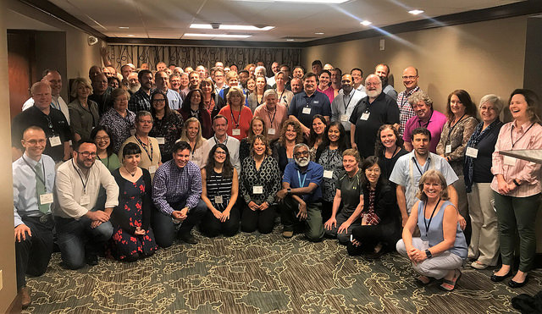
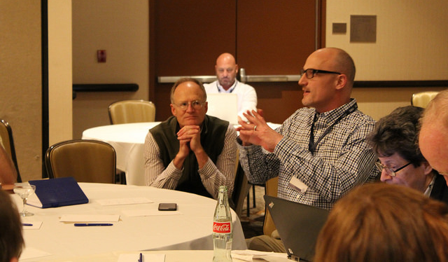
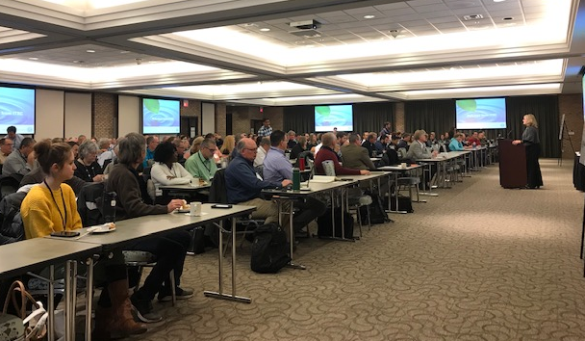
How We Achieve Our Mission
Select Projects
Form Team
Implement Solutions
Develop Documents, Training, and Other Tools
Conduct Training and Outreach
Notes:
ITRC develops guidance documents and training courses using multi-sector teams of experts. All teams are state-led and include a minimum of 5 state team members. The free documents are distributed around the country and associated free training courses are offered through the internet and in classroom settings. One unique and powerful aspect of ITRC products is that they are reviewed and edited by ITRC’s national network of hundreds of state regulators, as well as other ITRC members from federal agencies and the private-sector. Thus, ITRC guidance documents and training truly provide a national perspective.

Slide 10
ITRC Focus Areas
Land
Air
Remediation
Water
Notes:
Long list of topics:
Triad, SCAPS, Diffusion/passive samplers, Direct push wells,
Brownfields, Land use controls, Ecological enhancements, Ecological land reuse
Alternative landfill covers, Landfill bioreactors, Post-closure care at landfills
DNAPLs characterization, monitoring, and remediation approaches, DNAPL surfactant/cosolvent flushing
In situ bioremediation, Bioremediation of DNAPLs, Monitored natural attenuation, Enhanced attenuation
In situ chemical oxidation, Permeable reactive barriers, Thermal desorption
LNAPLs natural depletion, LNAPLs characterization, monitoring, and remediation approaches
Metals treatment, Natural attenuation of metals and radionuclides
MTBE, Perchlorate, Radionuclides
Phytotechnologies, Wetlands
Remediation Process Optimization and Risk Management
Risk assessment
Munitions, UXO, and small arms firing ranges
Vapor Intrusion

Slide 11
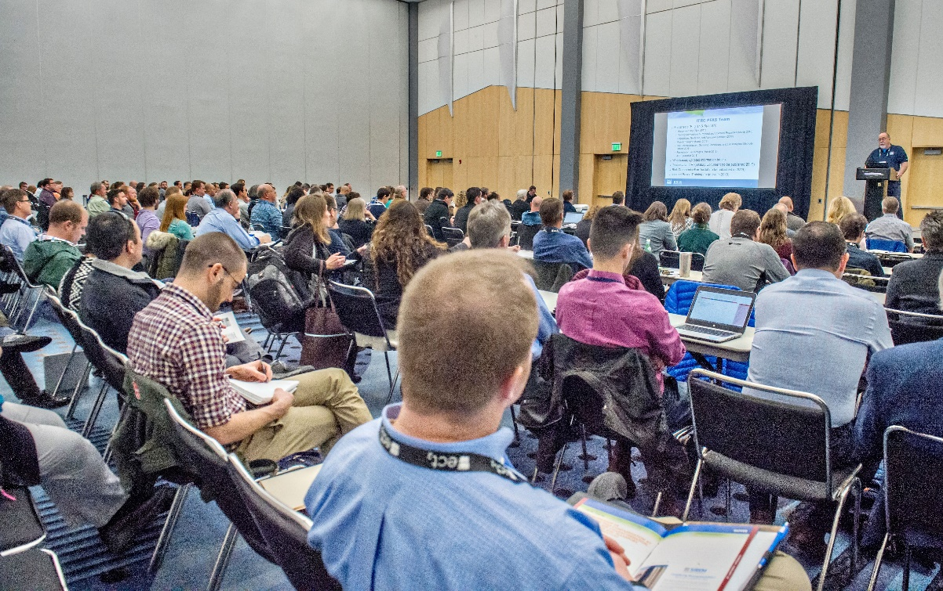
Our Impact
National network with over 1,000 members from 50 states
Database of over 35,000 environmental contacts
126 guidance documents
Training classes on 76 environmental topics
Over 20,000 unique website visitors per month
PFAS Training Class in Denver, Colorado

Slide 12
Our Unique Network
ITRC
Federal Government
Industry
Academia
State Government
Public & Tribal Stakeholders
ECOS/ERIS
Notes:
ITRC has a unique network that includes regulators and the regulated, from the government and private sector.
ITRC is a program of ECOS – the Environmental Council of States (national organization of state environmental agency commissioners) – and ERIS (Environmental Research Institute of the States) and ECOS staff provide administration for ITRC.
All ITRC Teams have a minimum of 1-2 state Team Leaders and 5 state members.

Slide 13
ITRC Project Development Process
Environmental Need
Project Transition
Product Use/
Success
Proposal Development
Team Formation
Product Development

Slide 14
2019 Teams
1,4-Dioxane (NEW)
Harmful Cyanobacterial Blooms (NEW)
Incremental Sampling Methodology Update (NEW)
Per- and Polyfluoroalkyl Substances (PFAS)
Advanced Site Characterization Tools (ASCT)
In Situ Optimization

Slide 15
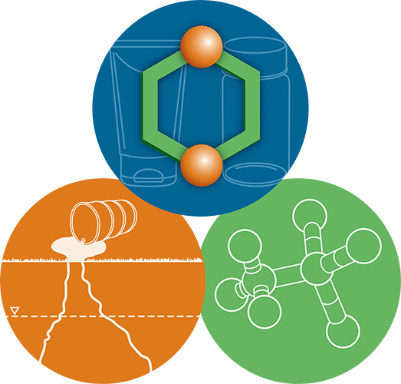
2019 Teams: 1,4-Dioxane
As of February 19
Began in January 2019
262 total members → 68 state members
Will produce a guidance document, training curricula, and fact sheets on:
Sources of Contamination
Detection Technologies
Remediation Technologies
Regulatory Framework
Risk Communication
What is 1,4-Dioxane (1,4-DX)?
A likely human carcinogen that has been used in food additives and laboratory and manufacturing processes. 1,4-DX releases into the surrounding environment through wastewater discharge, unintended spills, historical disposal practices of host solvents, and more.
Team Leaders
Kirsten Hiortdahl
North Carolina DEQ
Kirsten.hiortdahl@ncdenr.gov
Gladys Liehr
Florida DOH
Gladys.liehr@flhealth.gov

Slide 16
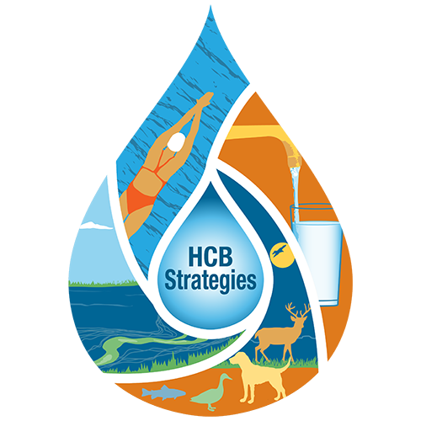
2019 Teams: Harmful Cyanobacterial Blooms
As of February 19
Began in January 2019
133 total members → 69 state members
Will produce a web tool, training curricula, and fact sheets on:
Development and Prevention
Management Practices
Risk Communication
What are Harmful Cyanobacterial Blooms (HCB)?
A complex ecological phenomenon that occurs when cyanobacteria proliferate and dominate an aquatic ecosystem. Triggers for increased HCBs include a rapidly warming climate and increased levels of nutrients in surface waters.
Team Leaders
Ben Holcomb
Utah DEQ
bholcomb@utah.gov
Angela Shambaugh
Vermont DEC
angela.shambaugh@vermont.gov

Slide 17
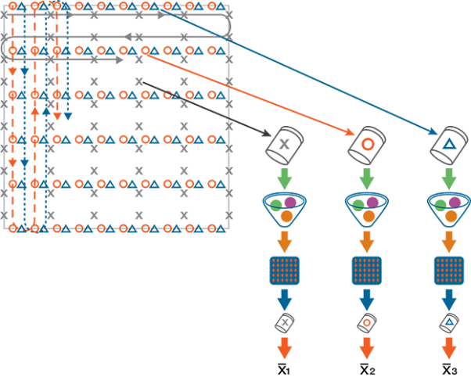
2019 Teams: Incremental Sampling Methodology
As of February 19
Began in January 2019
123 total members → 39 state members
Will update the ITRC 2012 ISM guidance and training to include:
What is Incremental Sampling Methodology (ISM)?
A structured sampling protocol that reduces data variability and increases sample representativeness. ISM significantly improves the reliability of sample data, as well as the time and cost needed to investigate and remediation soil and sediment contamination.
A focus on practical implementation of ISM-type sample collection and analysis
Stages of a site investigation
Team Leaders
Caroline Eigenbrodt
New York DEC
Caroline.eigenbrodt@dec.ny.gov
Troy Keith
Tennessee DEC
Troy.keith@tn.gov

Slide 18
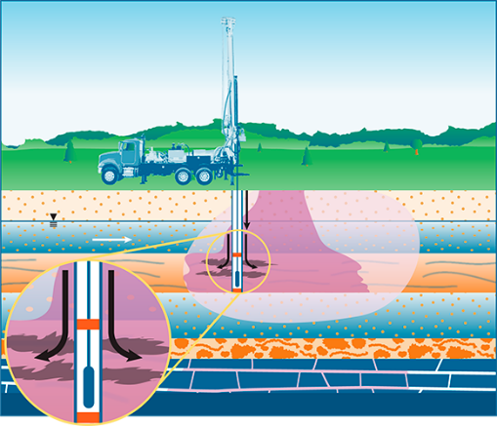
2019 Teams: In Situ Optimization
As of February 19
What is In Situ Remediation?
The application of chemical, physical and biological processes to the subsurface in order to treat contaminants in soil and groundwater. In situ treatment technologies can be economically and environmentally sound solutions utilized to remediate a wide range of organic and inorganic compounds, radionuclides, and other compounds.
Began in January 2018
167 total members → 46 state members
Will produce a guidance document and training curricula on:
Design Characterization
Screening
Design Implementation
Monitoring
Regulatory Considerations
Team Leaders
Dave Scheer
Minnesota PCA
Dave.scheer@mn.state.us
Janet Waldron
Massachusetts DEP
Janet.Waldron@state.ma.us

Slide 19
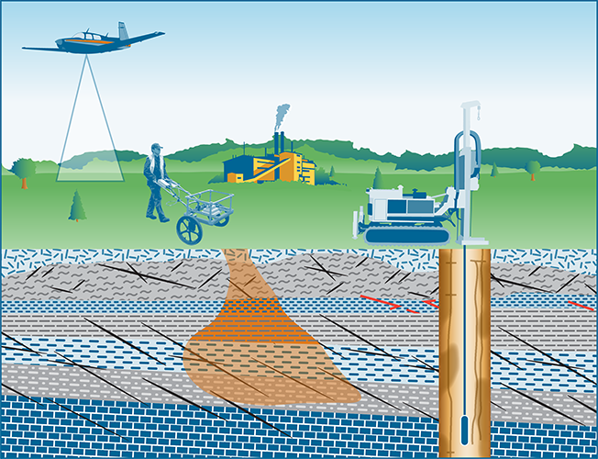
2019 Teams: Advanced Site Characterization Tools
As of February 19
Began in January 2018
171 total members → 56 state members
Will produce a guidance document and training curricula on:
Technology Overview
Direct Sensing
Geophysics
Remote Sensing
Regulatory Context
What are Advanced Site Characterization Tools?
Tools that can be used to provide a more precise and accurate conceptual site model. They are often capable of rapid implementation and data generation, providing high data density.
Team Leaders
Alexander Wardle
Virginia DEQ
Alexander.wardle@deq.virginia.gov
Edward Winner
Kentucky DEP
Edward.winner@ky.gov

Slide 20
2019 Teams: PFAS
As of February 19
What are Advanced Site Characterization Tools?
Tools that can be used to provide a more precise and accurate conceptual site model. They are often capable of rapid implementation and data generation, providing high data density.
Team Leaders
Alexander Wardle
Virginia DEQ
Alexander.wardle@deq.Virginia.gov
Edward Winner
Kentucky DEP
Edward.winner@ky.gov

Slide 21
ITRC Code of Conduct
When joining ITRC you agree to:
Promote the mission of ITRC and uphold its reputation.
Maintain high standards of integrity and professional conduct.
Conduct themselves in a manner that is beneficial for team consensus and collaboration.
Be respectful and courteous to other ITRC members and staff.
Not endorse nor disparage a company, product, technology, or any other entity while participating in an ITRC event.
Not engage in harassment or discriminate on the basis of race, color, religion, ancestry, national origin, sex, sexual orientation, age, or disability.

Slide 22
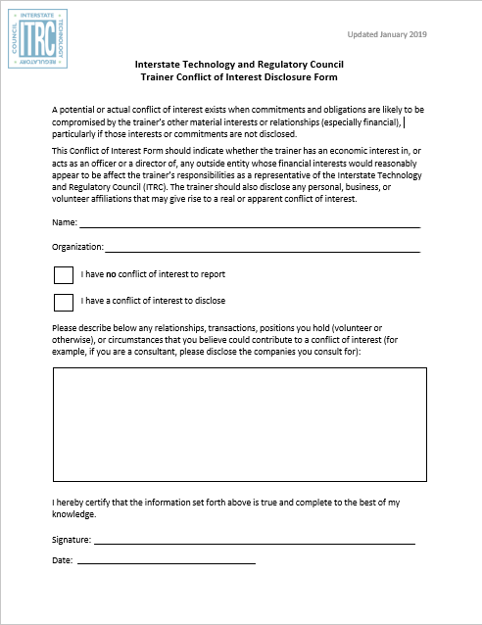
ITRC Trainer Conflict of Interest Disclosure Form
Trainers must disclose an economic interest and/or any personal, business, or volunteer affiliations that may give rise to a real or apparent conflict of interest.
Trainers must update the form annually should circumstances change.

Slide 23
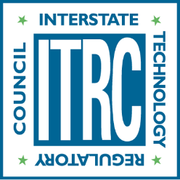
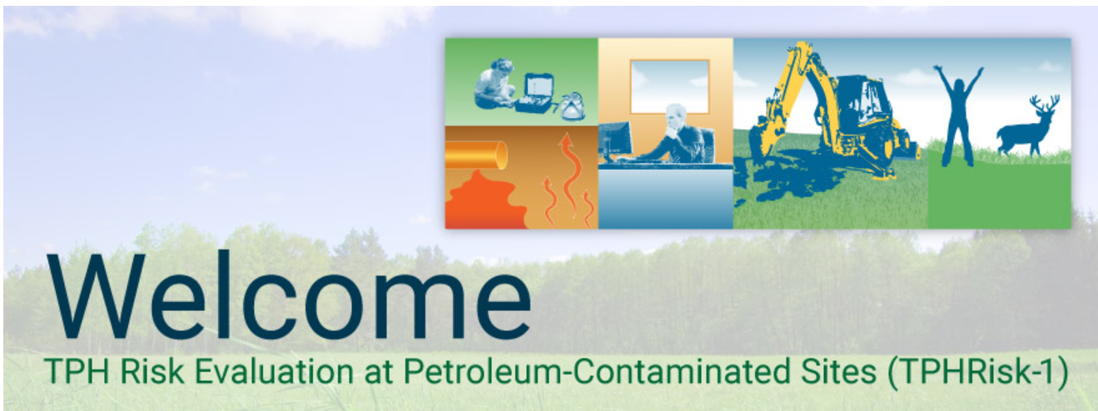
Website and Social Media Statistics
As of February 19
416 Followers
15,000 Monthly Users
@ITRCWEB
itrcweb.org
318 Followers
22,000 Monthly Users*
1,500 PDF Downloads
facebook.com/itrcweb
ITRC Online
Guidance Documents
2,686 Followers
*Entrances
linkedin.com/company/itrc

Slide 24
ITRC Accomplishments
Educates
state regulators on the use of innovative technologies
Promotes
the use of innovative technologies
Unites
state approaches to complex topics
Inspires
collaboration over adversarial relationships
Notes:
ITRC works to break down barriers by (1) increasing state regulators’ understanding and confidence in innovative technologies; (2) producing guidance documents and training that are used by environmental professionals across the country to increase regulatory consistency from state-to-state; (3) fostering integration of new technical developments within existing regulations; (4) creating networks of technical experts for use by states when making decisions on innovative environmental technologies; and (5) showing the cost and time savings that can be achieved with innovative environmental technologies.

Slide 25
Benefits To States
Information and technology transfer
Free training on how to use innovative environmental technologies and approaches
Access to peers and experts in other regulatory agencies
Shortened learning curve by obtaining advanced knowledge of innovative technologies and approaches
Cost-effective involvement in demonstrations conducted in other jurisdictions
Collaborative problem solving

Slide 26
ITRC Long Term Benefits
National paradigm shifts for using new technology
Harmonized approaches to using innovative technology across the nation
Increased regulatory consistency for similar environmental problems in different states
Reduced review/permitting times for innovative approaches to environmental problems
Faster decisions due to reduction in uncertainty

Slide 27
Reducing Barriers
Providing guidance and training developed for state regulators by our Teams
Increasing understanding and confidence in innovative technologies
Fostering integration of new technical developments
Creating networks of technical experts

Slide 28
Our Unique Network
As of March 7, 2019
907
Members
28
Notes:
ITRC has a unique network that includes regulators and the regulated, from the government and private sector.
ITRC is a program of ECOS – the Environmental Council of States (national organization of state environmental agency commissioners) – and ERIS (Environmental Research Institute of the States) and ECOS staff provide administration for ITRC.
All ITRC Teams have a minimum of 1-2 state Team Leaders and 5 state members.

Slide 29
2018 Industry Affiliates Program (IAP)

Slide 30
Private Sector Participation
Industry Members have been a part of ITRC since 1995
Represented in ITRC’s Board of Advisors
Provide a portion of ITRC’s budget
Participates in peer review of ITRC documents and training materials
Technical experts from private sector participate in ITRC teams
Act as instructors for ITRC training courses
Play an active role in future project selection
Take ITRC training courses

Slide 31
IAP Testimonials
“Our staff at TRC have relied upon ITRC technicalregulatory guidance documents and webinars for many years. Now, as an IAP member, we are able to be part of the process and contribute to these important documents. It has been a rewarding experience for TRC to participate in the ITRC model of broad collaboration and consensus-building with multiple stakeholders.” – Liz Denly, TRC
“As a small business our internal resources for technology development are limited by both time and money, so ITRC is a great way to keep up with new developments and meet the experts leading the charge. I frequently reach out to some of those people I met during the first few years when we are faced with a particularly challenging situation on our projects.” – Jeremy Musson, Pinyon Environmental

Slide 32
2018 Products
Technical and Regulatory Documents and Online Training were produced for the following Teams:
LNAPL Update
Quality Considerations for Multiple Aspects of Munitions Response Sites
Evaluation of Innovative Methane Detection Technologies
Stormwater BMPs
TPH Risk Evaluation at Petroleum-Contaminated Sites

Slide 33
2019 Planned Products
Project/Team | Fact Sheets | Tech Reg Document | Online Training
1,4-Dioxane
Harmful Cyanobacterial Blooms (HABs) | ●
Incremental Sampling Methodology Update (ISM)
Per- and Polyfluoroalkyl Substances (PFAS) |  | ●
Advanced Site Characterization Tools (ASCT)
In Situ Remediation

Slide 34
Training
Online Training
Classroom Training
See www.itrcweb.org for full training schedule
Notes:
ITRC training is based on ITRC technical and regulatory guidance documents and focused on increasing understanding and use of ITRC documents. Internet-based training is hosted in conjunction with EPA’s Clu-in Website and is free (and cost-effective, since no travel is required). Most internet-based training courses are available in archived form for on-demand viewing. ITRC offering Vapor Intrusion classroom training in Michigan October 2017. See www.itrcweb.org for more information.

Slide 35
Training: 1997 to 2018

Slide 36
Training: 1997 to 2018

Slide 37
2019 ITRC Courses
Connecting the Science to Managing LNAPL Sites Part 1: Understanding LNAPL Behavior in the Subsurface
Geospatial Analysis for Optimization at Environmental Sites
Connecting the Science to Managing LNAPL Sites Part 2: LNAPL Conceptual Site Models and the LNAPL Decision Process
Connecting the Science to Managing LNAPL Sites Part 3: Using LNAPL Science, the LCSM, and LNAPL Goals to Select an LNAPL Remedial Technology
Characterization and Remediation in Fractured Rock
Issues and Options in Human Health Risk Assessment – A Resource When Alternatives to Default Parameters and Scenarios are Proposed
Bioavailability of Contaminants in Soil: Considerations for Human Health Risk Assessment
Remediation Management of Complex Sites
TPH Risk Evaluation at Petroleum-Contaminated Sites
Groundwater Statistics for Environmental Project Managers
Long-term Contaminant Management Using Institutional Controls
Integrated DNAPL Site Characterization
Characterization and Remediation in Fractured Rock

Slide 38
2019 ITRC Courses (Continued)
Petroleum Vapor Intrusion: Fundamentals of Screening, Investigation, and Management
Geospatial Analysis for Optimization at Environmental Sites
Connecting the Science to Managing LNAPL Sites Part 1: Understanding LNAPL Behavior in the Subsurface
Connecting the Science to Managing LNAPL Sites Part 2: LNAPL Conceptual Site Models and the LNAPL Decision Process
Bioavailability of Contaminants in Soil: Considerations for Human Health Risk Assessment
Connecting the Science to Managing LNAPL Sites Part 3: Using LNAPL Science, the LCSM, and LNAPL Goals to Select an LNAPL Remedial Technology
ITRC Interactive Panel: Stormwater Best Management Practices Performance Evaluation
TPH Risk Evaluation at Petroleum-Contaminated Sites
Remediation Management of Complex Sites
Long-term Contaminant Management Using Institutional Controls
Characterization and Remediation in Fractured Rock
ITRC Interactive Panel: Stormwater Best Management Practices Performance Evaluation
TPH Risk Evaluation at Petroleum-Contaminated Sites

Slide 39
2019 ITRC Courses (Continued)
Issues and Options in Human Health Risk Assessment – A Resource When Alternatives to Default Parameters and Scenarios are Proposed
Groundwater Statistics for Environmental Project Managers
Connecting the Science to Managing LNAPL Sites Part 1: Understanding LNAPL Behavior in the Subsurface
Bioavailability of Contaminants in Soil: Considerations for Human Health Risk Assessment
Connecting the Science to Managing LNAPL Sites Part 2: LNAPL Conceptual Site Models and the LNAPL Decision Process
Connecting the Science to Managing LNAPL Sites Part 3: Using LNAPL Science, the LCSM, and LNAPL Goals to Select an LNAPL Remedial Technology
Petroleum Vapor Intrusion: Fundamentals of Screening, Investigation, and Management
Geospatial Analysis for Optimization at Environmental Sites
Remediation Management of Complex Sites
Characterization and Remediation in Fractured Rock
Long-term Contaminant Management Using Institutional Controls
TPH Risk Evaluation at Petroleum-Contaminated Sites
ITRC Interactive Panel: Stormwater Best Management Practices Performance Evaluation

Slide 40
State Engagement Network
In 2017, all 50 states, DC, and Puerto Rico have confirmed Points of Contact (POCs)
POC Responsibilities:
Review ITRC documents
Submit state environmental priorities to ITRC
Respond to survey requests
Indicate expected level of participation in ITRC proposed projects
Participate in training dry runs
Contribute to project technical and implementation sessions
Submit ITRC success stories
Recruit state Team Leaders and members for ITRC Teams
Provide state concurrence on ITRC technical regulatory guidance documents
Notes:
The POC Network is one of ITRC’s more important features. ITRC has one of the deepest, if not the deepest, network of state environmental regulators available. Because of ITRC’s reach into the state environmental agencies, its guidance documents and training truly represent a national perspective. One benefit of this national perspective is harmonization of state regulatory approaches across the nation. Another is that ITRC is a powerful state network that can be used by states to maximize their resources. For example, states without technical experts in emerging areas can use ITRC’s network as a resource for addressing technical challenges and decision making on innovative environmental technologies/approaches.

Slide 41
23 Years of State Engagement
ITRC’s Board of Advisors is led by state agency representatives
States become official members of ITRC by appointing a POC. The POCs:
Facilitate communication within the state
Identify state priorities and emerging issues
Coordinate state reiew of draft documents and dry-run training
Promote the use of ITRC documents and training within the state
Each ITRC Team is led by 1-2 state agency Team Leaders and has a minimum of 5 state agency team members
Notes:
The number of POCs reflects upon ITRC reach into the state environmental agencies. ITRC has a deep state network as a minimum of 80% of states appoint ITRC POCs, which act in a 2-way communication role between states and ITRC. The main role of the ITRC POC is to increase use of ITRC documents and training. However, they also contribute in a number of other important ways listed in this slide.

Slide 42
Benefits To States
Information and technology transfer
Free training on how to use innovative environmental technologies and approaches
Access to peers and experts in other regulatory agencies
Shortened learning curve by obtaining advanced knowledge of innovative technologies and approaches
Cost-effective involvement in demonstrations conducted in other jurisdictions
Collaborative problem solving

Slide 43
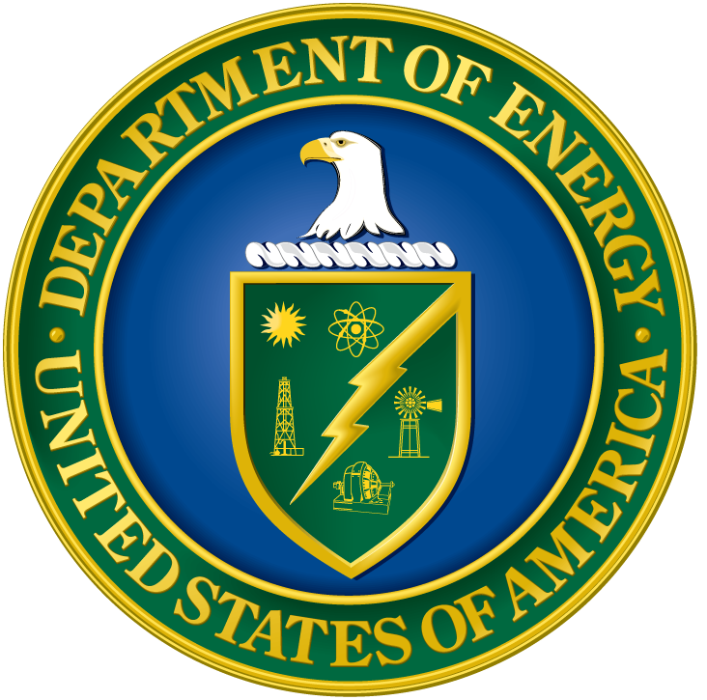
Federal Government Participants
Notes:
Collectively EPA, DOD, and DOE:
Have partnered with ITRC since 1995
Are members of the ITRC Board of Advisors
Provided about 70% of ITRC’s budget in 2016
Provide peer review of ITRC documents and training courses
Provide technical experts for ITRC teams
Provide instructors for ITRC training courses
Play an active role in future project selection
Take ITRC training courses

Slide 44
Benefits to DOD and DOE
Encourages use of innovative environmental solutions
Increases reliance on cost-effective cleanup approaches
Reduces review and approval times for innovative approaches to environmental problems
Facilitates interactions between federal managers and state regulators
Increases consistency of regulatory requirements for similar environmental problems in different states
Addresses environmental needs that are relevant to DOD and DOE

Slide 45
Benefits to EPA
Provides knowledge transfer to states for better environmental protection
Encourages use of innovative environmental solutions by states and others
Increases state reliance on cost-effective cleanup approaches
Facilitates idea sharing between federal managers and state regulators
Provides a mechanism for identifying and integrating regulatory performance expectations among states
Unique and cost-effective approach for demonstrating and deploying new technologies and approaches

Slide 46
Benefits to the Private Sector
Cutting-edge information on innovative environmental technologies and approaches
Opportunities to author national guidance documents and participate in training courses
Insight into the regulatory world
Access to multiple state and federal government entities
Opportunity for broader review of technology
National approach to demonstration and deployment of new technology
Mechanism to identify and integrate regulatory performance expectations among states

Slide 47
How Can YOU Benefit from ITRC?
Use ITRC Documents
Take ITRC Training Courses
Join ITRC Teams
Contact Your State POC

Slide 48
2019 Teams
1,4-Dioxane (NEW)
Harmful Cyanobacterial Blooms (NEW)
Incremental Sampling Methodology Update (NEW)
Vapor Intrusion Mitigation Training (NEW)
Green and Sustainable Remediation with Resiliency to Extreme Weather Events and Wildfires (NEW)
Per- and Polyfluoroalkyl Substances (PFAS)
Advanced Site Characterization Tools (ASCT)
In Situ Optimization

Slide 49
Thank You!
Stay Updated on ITRC’s Activities
itrcweb.org
facebook.com/itrcweb
@ITRCWEB
linkedin.com/ company/itrc

