Slide 1
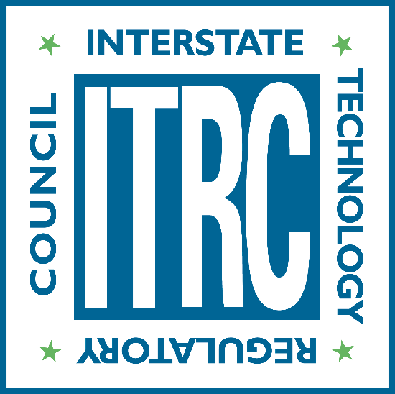
What is the ITRC?
Updated January 2025

Slide 2
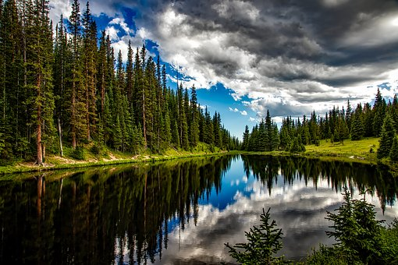
What is ITRC?
ITRC is a program of the Environmental Research Institute of the States (ERIS), a 501(c)3 education and research nonprofit affiliated with the Environmental Council of States (ECOS)
State-led national coalition with membership from state, federal, tribal, and international government agencies, academia, private sector, and the public stakeholders
Develops training materials and documents to provide technical knowledge and best management practices for addressing environmental challenges
Notes:
ITRC is a state-led environmental coalition focused on developing practical solutions and best practices. ITRC provides documents and training to expand technical knowledge and support efficient regulatory decision-making that safeguards human health and the environment. It operates as a program of the Environmental Research Institute of the States (ERIS), a nonprofit managed by the Environmental Council of the States (ECOS), which represents environmental leaders across states and territories. ITRC’s membership includes representatives from states, along with federal, tribal, international agencies, academia, and the private sector.

Slide 3
Benefits
Encourages use of innovative environmental solutions
Facilitates idea sharing and best practices between federal and state regulators
Unique and cost-effective approach for demonstrating and deploying new technology/approaches
Promotes strong partnerships and relationships between public and private sectors
Reduces review & approval times for innovative approaches to environmental problems
Increases consistency of regulatory requirements for similar environmental problems in different states
Provides free training
Notes:
ITRC offers valuable resources for those involved in environmental protection and technology implementation. It provides free training on innovative environmental technologies and approaches, helping users stay up to date while shortening the learning curve. Participants gain access to a network of peers, experts, and regulatory agencies, allowing for collaborative problem-solving and the exchange of best practices. ITRC also offers a unique opportunity to contribute to national guidance documents, participate in demonstrations across jurisdictions, and influence the distribution of cost-effective, innovative solutions. By connecting state and federal entities, ITRC supports a unified approach to regulatory performance, helping to advance environmental protection through collaboration and knowledge transfer.

Slide 4
ITRC Membership
ITRC
Government Agencies
Private Sector
Academia
Public Stakeholders
ECOS/ERIS
Tribal Stakeholders
FREE for government agencies, Tribal stakeholders, academia, and public stakeholders
Private Sector participation through our Industry Affiliates Program.
Learn from & network with a diverse group of environmental professionals with several areas of expertise
Write & review documents
Develop and deliver training
Leadership & professional development opportunities
Notes:
ITRC offers a unique network that brings together regulators and industry professionals from government and private sectors. As a program of ECOS and ERIS, it is administered by ECOS staff. Each ITRC team includes at least 1-2 state leaders and five state members, with free participation for state and federal employees. Members benefit from opportunities to network with environmental professionals, collaborate on document development, deliver training, and access leadership and professional development experiences.

Slide 5
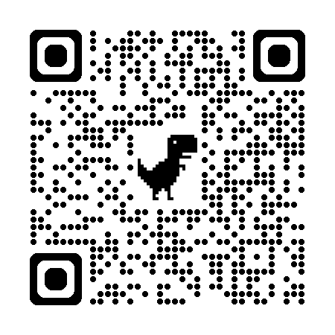
Current Project Teams & Upcoming Trainings
Project Teams
Upcoming Trainings
https://itrcweb.org/project-teams/
https://itrcweb.org/online-training/
Notes:
ITRC brings together experts from various sectors to develop solutions for complex environmental challenges. One of the key ways ITRC achieves this is through its Project Teams and ongoing live and archived Trainings. Each team focuses on a specific emerging or priority environmental issue, conducting research and creating resources that help regulators and practitioners implement science-based best practices. To learn more about ITRC’s current project teams and upcoming trainings visit out website.

Slide 6
Stay Updated on ITRC’s Activities
itrcweb.org
@itrc-environment
linkedin.com/ company/itrc
Notes:
LinkedIn: Follow at linkedin.com/company/itrc.
Website: Access comprehensive resources at itrcweb.org.

