Slide 1
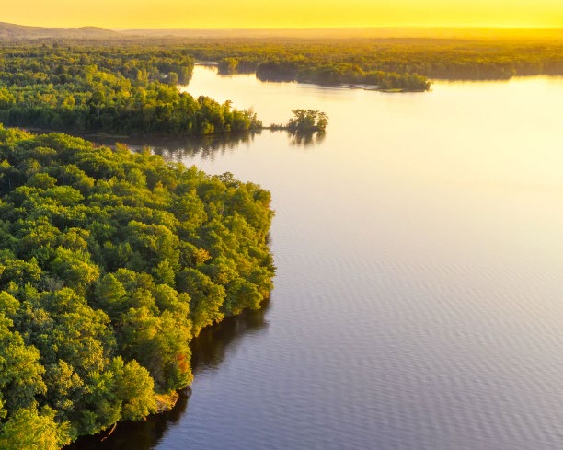
BRAND GUIDE
INTERSTATE TECHNOLOGY & REGULATORY COUNCIL
UPDATED 02/2025

Slide 2


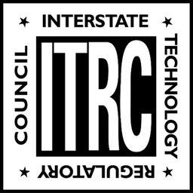

MASTER LOGOS
ITRC Clear Background
ITRC White Background
ITRC Clear Background - White
ITRC Black and White

Slide 3

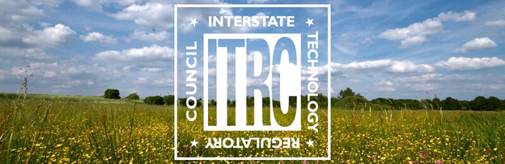
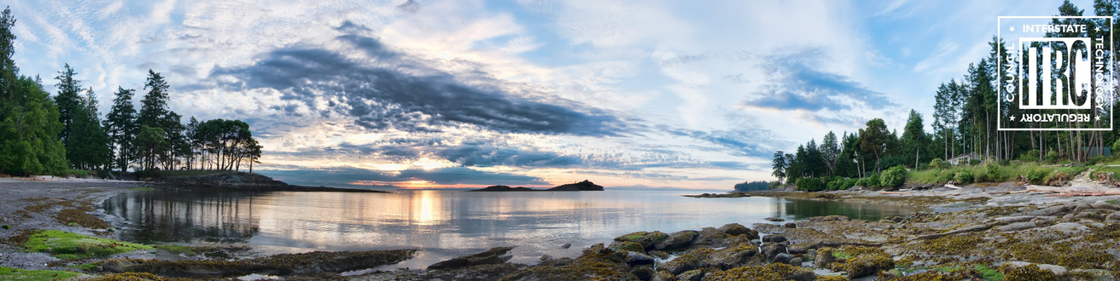
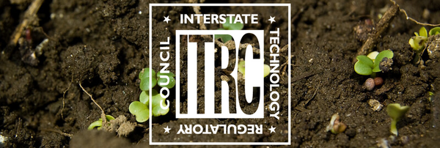
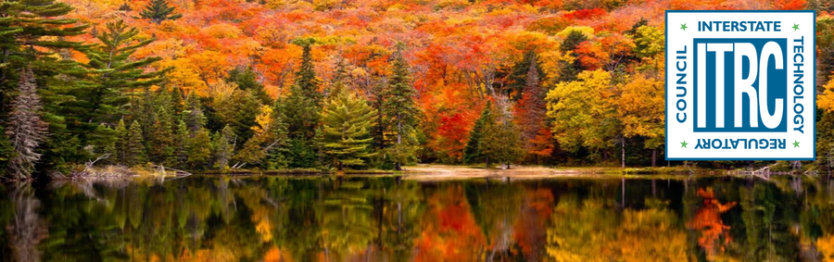
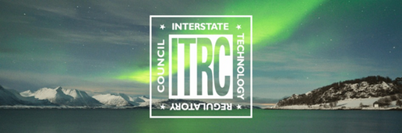
ITRC BANNERS
ITRC banners can be used for promotional materials including email marketing, LinkedIn, and more.
ITRC Banner - Elements
ITRC Banner - Summer
ITRC Banner - Small Logo Summer
ITRC Banner - Soil
ITRC Banner - Fall
ITRC Banner - Winter

Slide 4
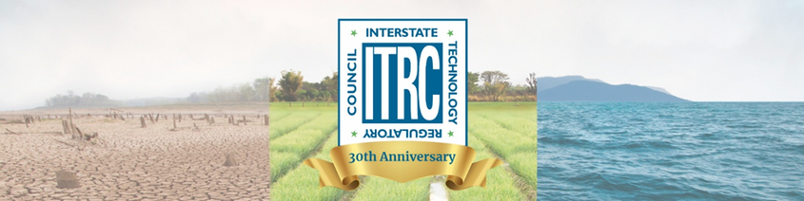
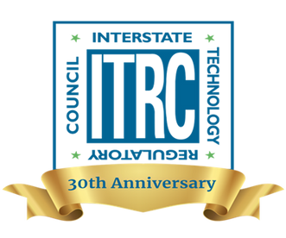

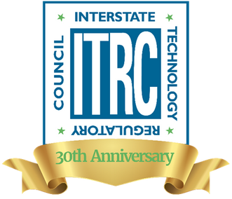
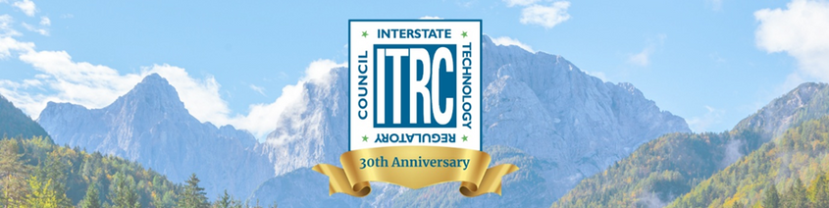
30TH ANNIVERSARY LOGOS AND BANNERS
To be used throughout 2025, in our 30th year.

Slide 5




ITRC EMAIL SIGNATURES
Email signatures for current members serving on Project Teams, as trainers, on the board, or IAP.

Slide 6
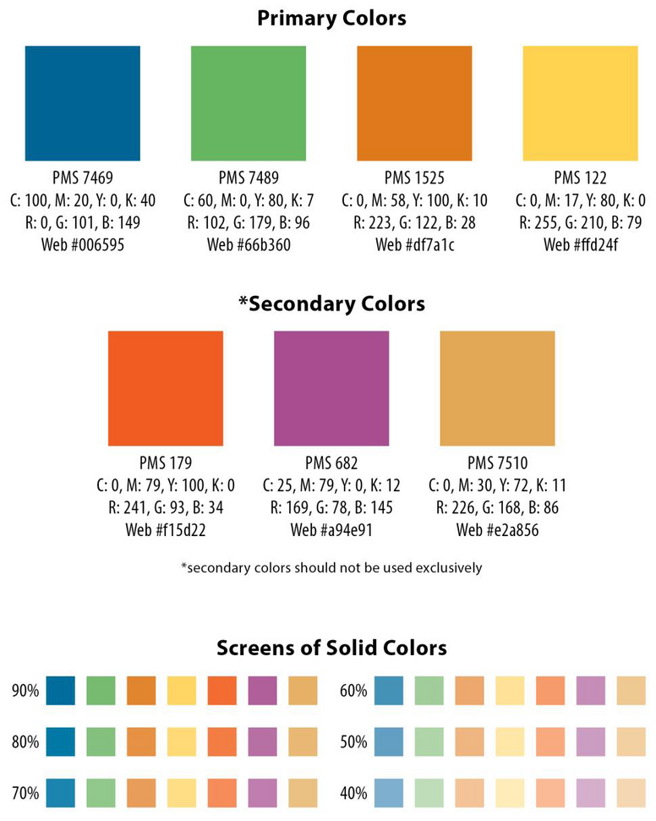
COLOR PALETTE
Primary Colors
PMS 7469
C: 100, M: 32, Y:0, K: 42
R: 0, G: 101, B: 149
Web#006595
PMS 7489
C: 43, M:0, Y:46, K: 30
R: 102, G: 179, B:96
Web#66b360
PMS 1525
C: 0, M: 36, Y: 88, K: 11
R: 228, G: 122, B: 28
Web#df7a1c
PMS 122
C: 0, M: 18, Y: 69, K: 0
R: 255, G: 210, B: 79
Web#ffd24f
Secondary Colors
PMS 179
C: 0, M: 61, Y: 86, K: 5
R: 241, G: 93, B: 34
Web#f15d22
PMS 682
C: 0, M: 54, Y: 14, K: 34
R: 169, G: 78, B: 145
Web#a94e91
PMS 7510
C: 0, M: 26, Y: 62, K: 11
R: 226, G: 168, B: 86
Web#e2a856

Slide 7
CONTACT US
E-mail
itrc@itrcweb.org
Website
www.itrcweb.org
Address
1250 H St. NW Suite 850 Washington, D.C. 20005

